Slide 1
Airline Industry Key Players Analysis
Ivan Escalona-Faria
Andrew Josephson
Dipika Kumar
Jae-Lee
Heloisa Walsh
Notes:
Hel – Welcome and roll into intro

Slide 2
Intro
Consulting with Delta to increase market share
Working with top three people movers
https://www.worldatlas.com/articles/the-world-s-largest-airlines-by-passengers-carried.html
Notes:
Hel – Intro – still working on this one.

Slide 3
Visuals
Routes by Airline
Revenue
Top Destinations
Flight Paths
Notes:
Hel - brief mention of the types of charts we will show but first, the creating of the data. Turn over to Jae/Ivan.

Slide 4
Process
Joined two datasets
Airline flight data
Airport location data
https://openflights.org/data.html
SQLite database created
US Domestic routes only
Plotting
Leaflet
Sankey
New library used
Notes:
Jae and Ivan – speak to the creation of our data and pieces to get to the plotting phase. Mention the types of plots we used, maybe mention the types of plots we tried (D3). Mention Dipika’s library but leave it to her to tell the story when it’s her turn.

Slide 5
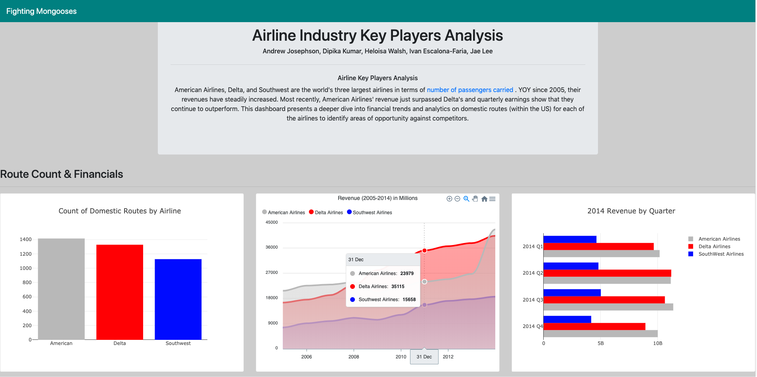
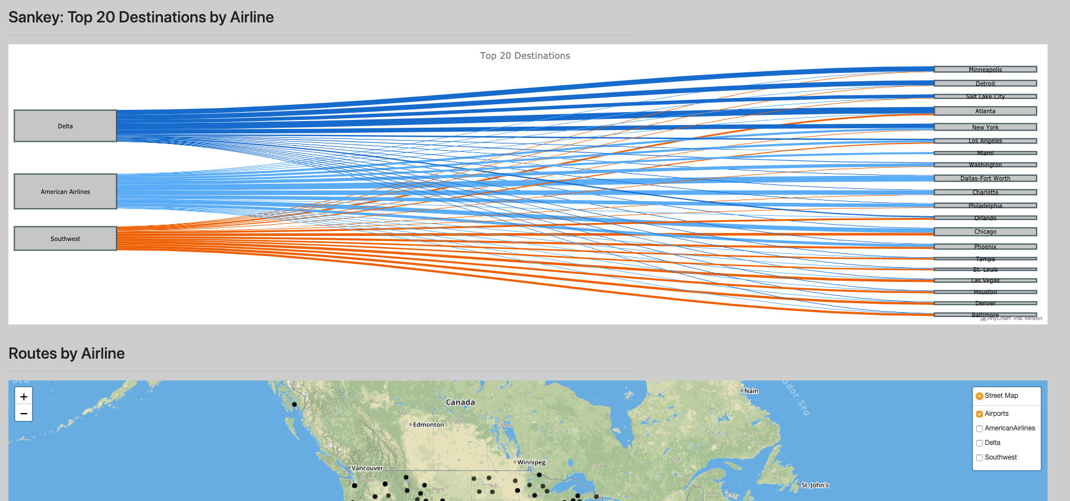
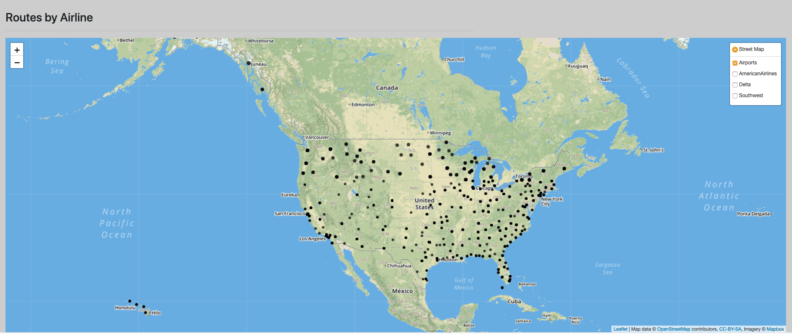
Notes:
Hel or Jae can speak if this screen shot is needed. Showing site layout in case we have technical issues. *Animations included-clicker can be used-shows the site as if we scrolled (animations with mac are different than PC, did my best).

Slide 6
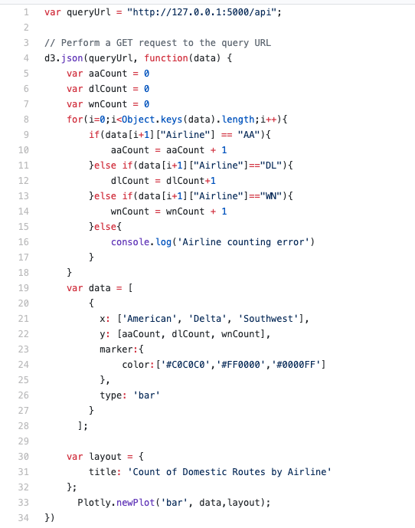
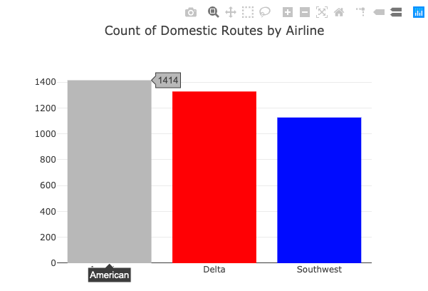
Bar chart of domestic routes by airline
Notes:
Jae – brief description of data pull. Note the separation of each airline as it’s key to most charts/maps.

Slide 7
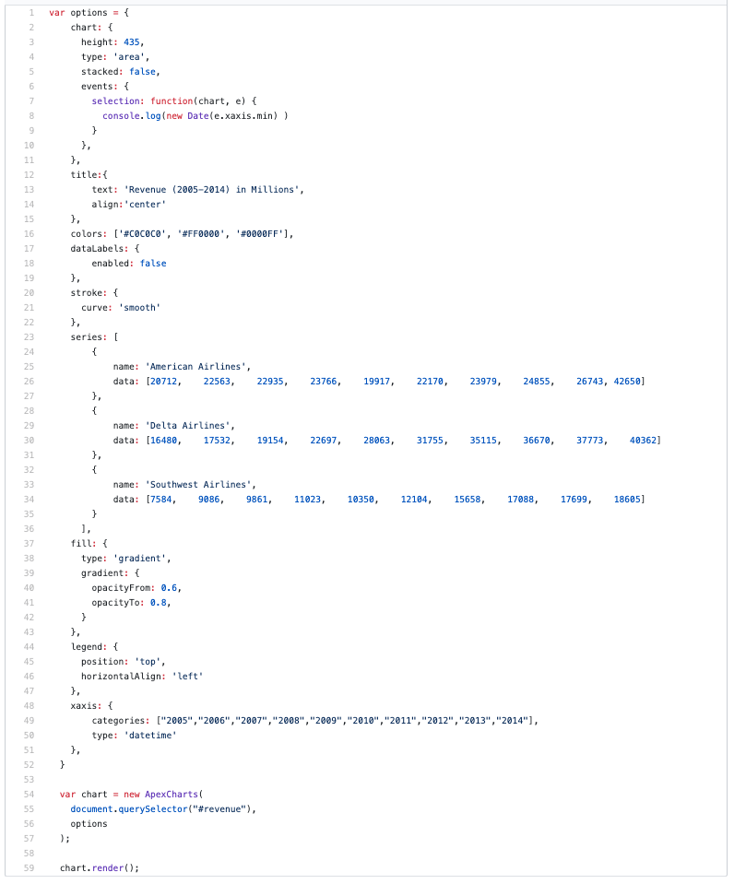
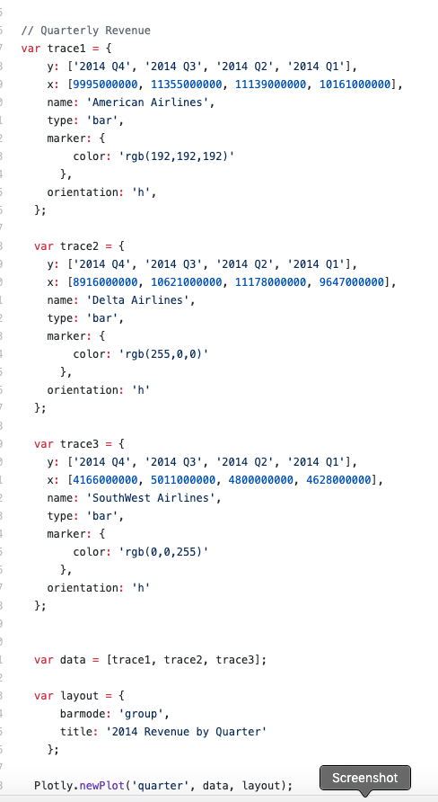
Revenue chart code
Notes:
*Dipika – notes on your fun quest on the library, you can mention the hard coding of revenue since that wasn’t part of the initial pull. Apex library for the YOY revenue and plotly for quarterly/needing to build 3 separate variables to pull the full chart together…

Slide 8
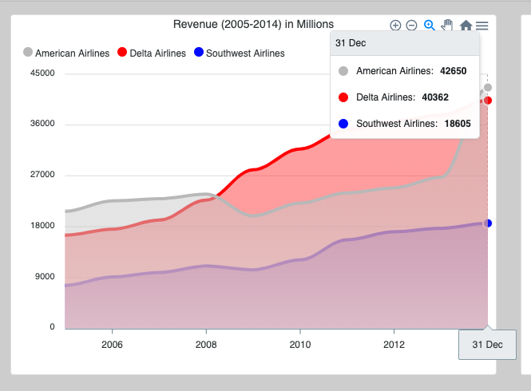
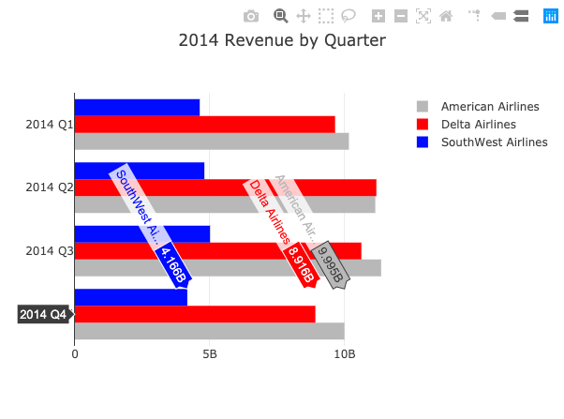
Revenue charts
Insert talking points
and code sample
Apex-charts library
React based
Plotly
https://www.macrotrends.net
Notes:
*Image shows hover information
Results of revenue chart code

Slide 9

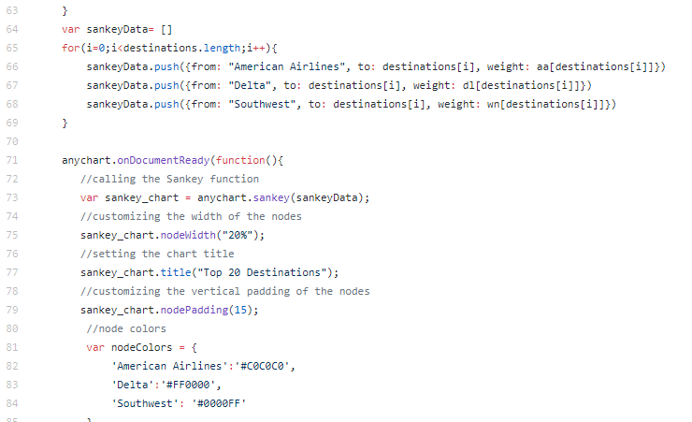


Top destinations
Sankey
Source
Target
Measure
Delta
Atlanta
New York
Chicago
American Airlines
Chicago
Dallas
New York
Southwest
Dallas
Los Angeles
http://vizdiff.blogspot.com/Creating-Sankey-Chart-As-Easy-As-1-2-3.html
Notes:
Andrew – talk about Sankey and the requirements to build the chart.

Slide 10
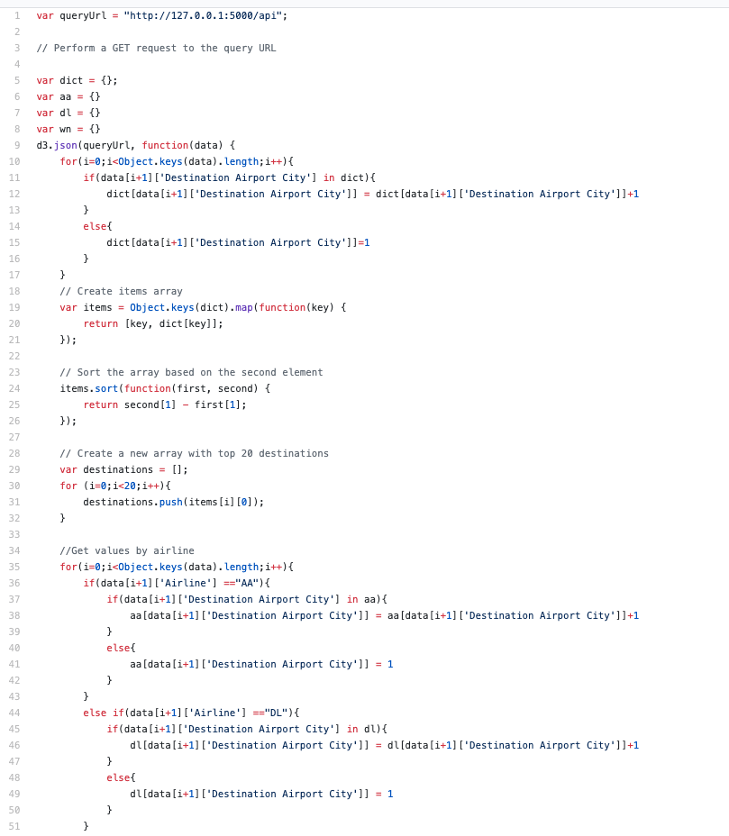
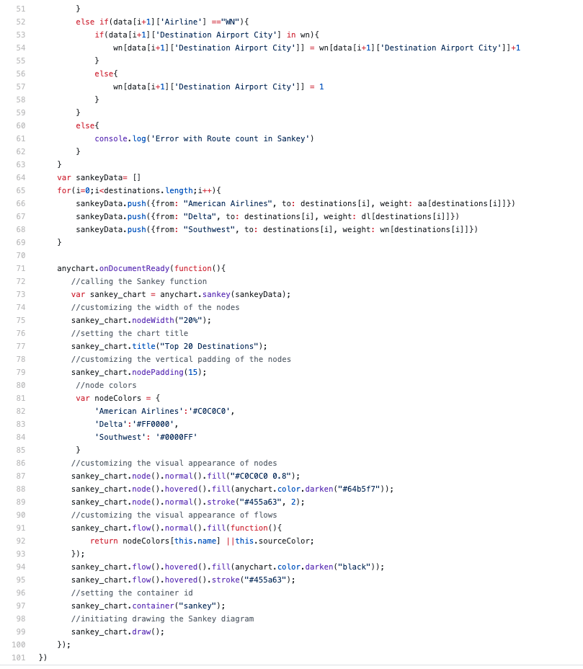
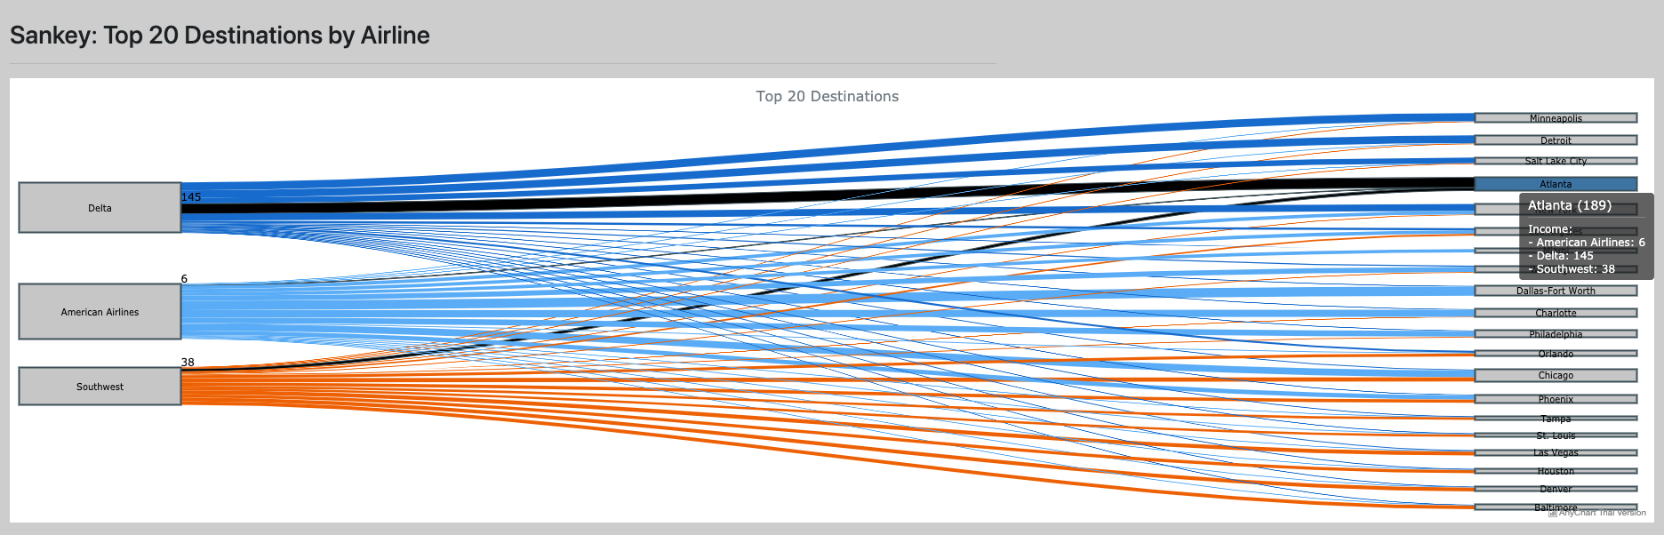
Top destinations
Notes:
Andrew – talks to Sankey creation and issues working with the formatting.

Slide 11



Flight paths
Domestic flight routes
American: 1,414
Delta: 1,327
Southwest: 1,126
Source: Natural Earth States and Provinces boundaries without large lakes
Notes:
Hel - Our goal was to show the flight paths for the top 3 people carriers, hoping to highlight any deficiencies for Delta to capture. Once the data was cleaned up, it became a matter of pulling the airport names. Separating out each flight path according to the airline and mapping all that using overlays to show the different airlines based on color. We settled on using Leaflet to utilize the overlays and legend functionality for easy display.

Slide 12
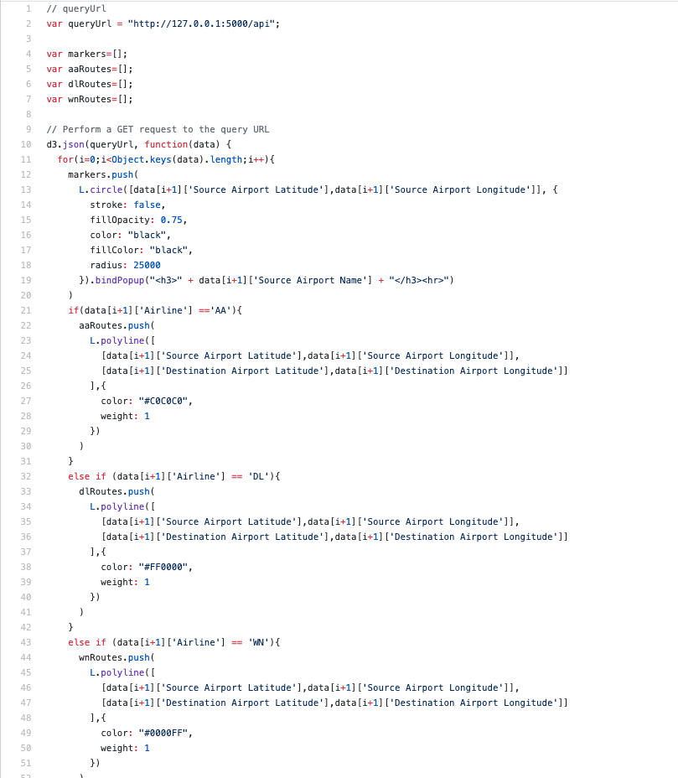
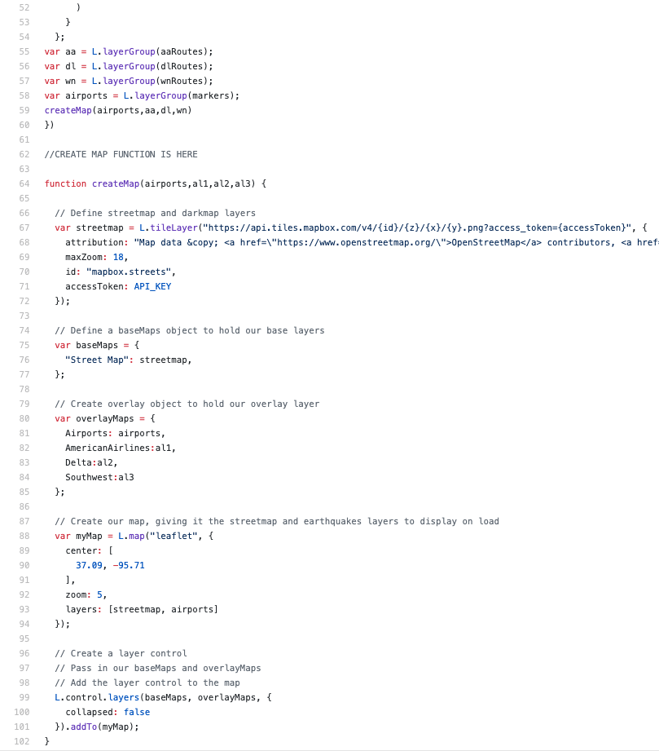
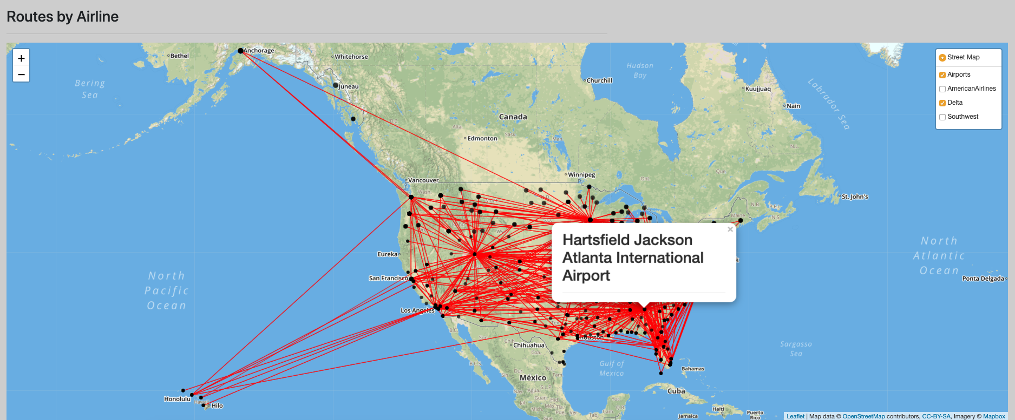
Flight paths
Notes:
Hel and Ivan – We tackled this mess in a few different ways but ended with Leaflet. Here is an example showing Delta flight paths. Each airport location has a name pop-up associated to it’s location.

Slide 13

Conclusion
Travel photo created by creativeart - www.freepik.com

Slide 14



Questions?
Our faces on Python and SQL
Our faces on Javascript
Notes:
Javascript was a beast and we appreciate the experience. Very much looking forward to diving into Tableau! Thank you.

